Slide 1
Semantic Communication: Fundamentals, Challenges and Future Directions
Presenter: Ziyang Wei
04/18/2025
1
1

Slide 2
Outline
Introduction
Technical Approaches
Security Challenges
Future Directions
Conclusion
2

Slide 3
Introduction Technical Approaches Security Challenges Future Directions Conclusion
3

Slide 4
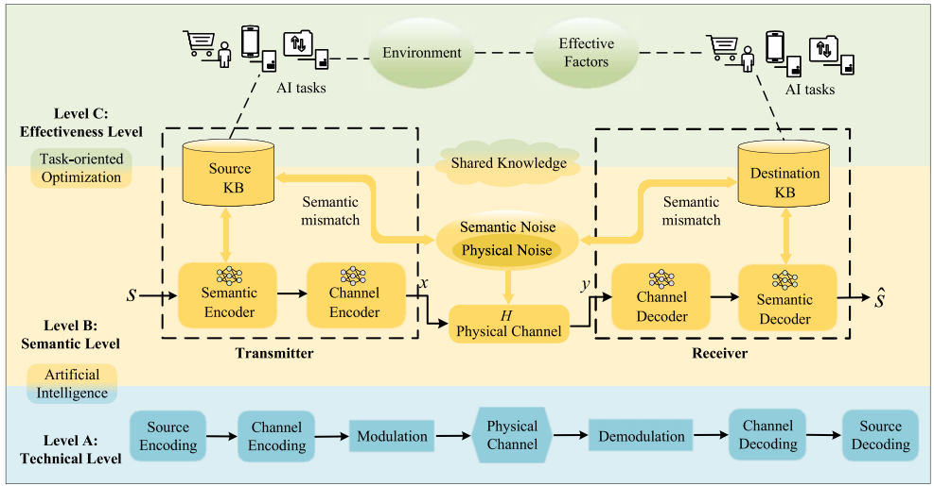
Motivation
Limitations of Traditional Communication
Focuses on bit-level transmission accuracy.
Semantic meaning is not considered in system design.
Semantic understanding depends on context and shared knowledge.
4
Z. Lu et al., "Semantics-Empowered Communications: A Tutorial-Cum-Survey," in IEEE Communications Surveys & Tutorials, vol. 26, no. 1, pp. 41-79, Firstquarter 2024

Slide 5
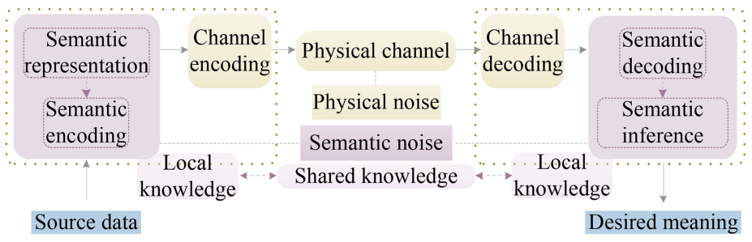
What is Semantic Communication?
Semantic Communication (SemCom) refers to the process of transmitting meaningful information between transmitter and receiver.
Encoder extracts semantic features (images → feature vectors).
Feature vectors transmitted over a communication channel.
Decoder reconstructs the original information.
5
W. Yang et al., "Semantic Communications for Future Internet: Fundamentals, Applications, and Challenges," in IEEE Communications Surveys & Tutorials, vol. 25, no. 1, pp. 213-250, Firstquarter 2023
Notes:
Do not transmit all original data, discard redundant data, and only transmit key information that can completely restore the original data.Since semantic communication transmits key information instead of all data, the bandwidth requirement is much lower than traditional communication.

Slide 6
Introduction Technical Approaches Security Challenges Future Directions Conclusion
6

Slide 7
Technical Approaches
Classical Semantic Information Theory
Knowledge Graph-Based Communication
Deep Learning-Based Approaches
Goal-Oriented Communication
7

Slide 8
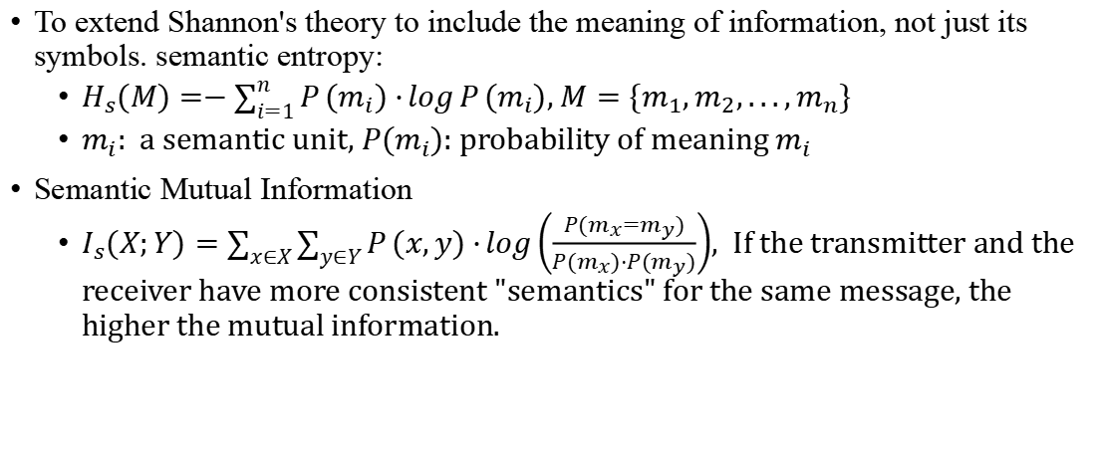
Classical Semantic Information Theory
To extend Shannon's theory to include the meaning of information, not just its symbols. semantic entropy:
$H_{s}(M)=−\sum_{i=1}^{n}{P}(m_{i})⋅\log{P}(m_{i})$, $M=\{m_{1},m_{2},...,m_{n}\}$
$m_{i}$: a semantic unit, $P(m_{i})$: probability of meaning $m_{i}$
Semantic Mutual Information
$I_{s}(X;Y)=\sum_{x∈X}{\sum_{y∈Y}{P}}(x,y)⋅\log\left(\frac{P(m_{x}=m_{y})}{P(m_{x})⋅P(m_{y})}\right)$, If the transmitter and the receiver have more consistent "semantics" for the same message, the higher the mutual information.
8
Z. Lu et al., "Semantics-Empowered Communications: A Tutorial-Cum-Survey," in IEEE Communications Surveys & Tutorials, vol. 26, no. 1, pp. 41-79, Firstquarter 2024

Slide 9
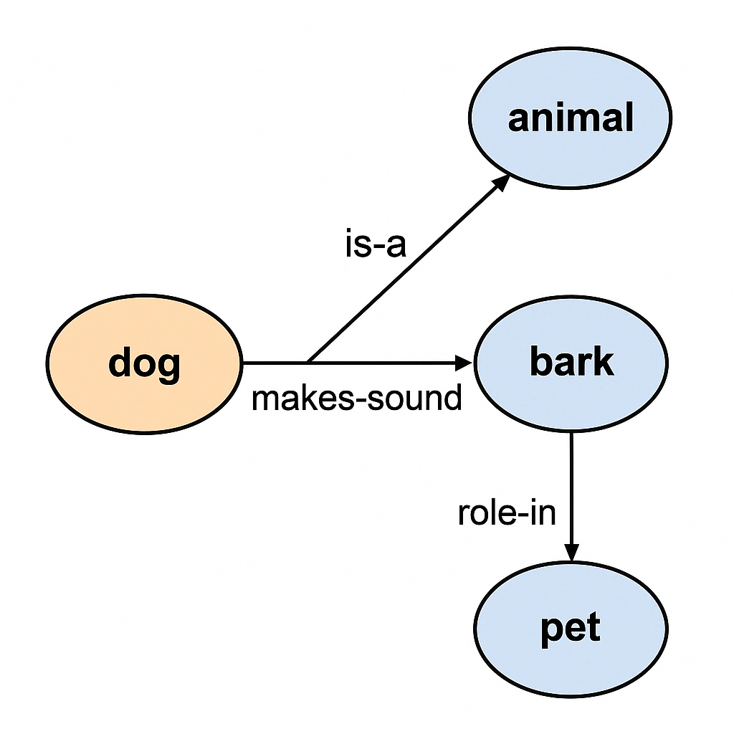
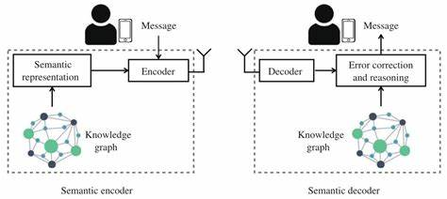

Knowledge Graph-Based Semantic Communication
Knowledge Graph (KG): structured graph of entities and relations.
A graph-based semantic structure: $G=(V,E)$, V: nodes = entities/concepts, E: edges = semantic relations
Encoder extracts semantic triplets, e.g.:(dog, is-a, animal)
Receiver reconstructs meaning using shared Knowledge Base.
9
Z. Lu et al., "Semantics-Empowered Communications: A Tutorial-Cum-Survey," in IEEE Communications Surveys & Tutorials, vol. 26, no. 1, pp. 41-79, Firstquarter 2024

Slide 10
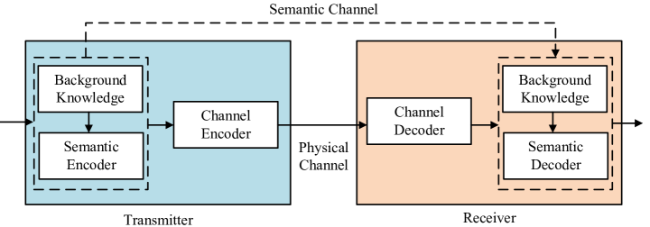

Deep Learning-Based Semantic Communication
Core Idea: Use neural networks to extract, compress, and reconstruct semantic representations from raw data.
Autoencoder-style structure:
$SemCom: x→f_{θ}(x)→Channel→g_{φ}(⋅)→\hat{x}$
10

Slide 11
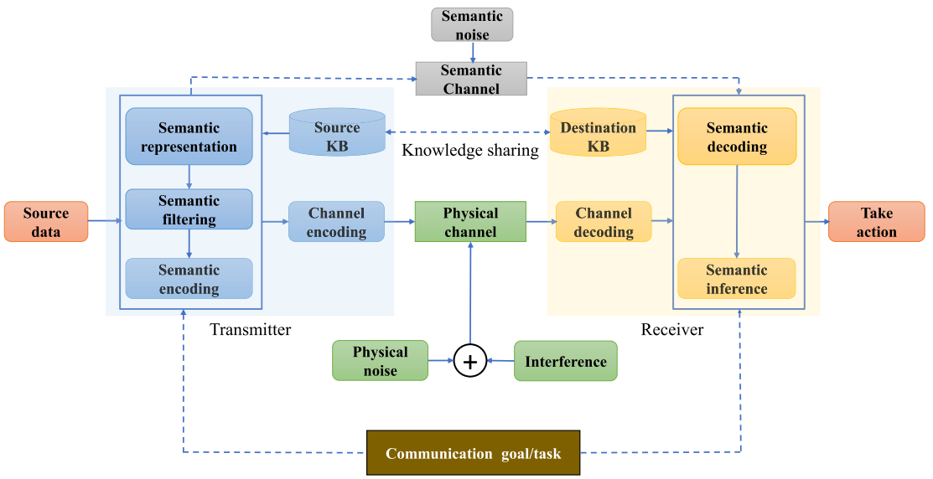
Goal-Oriented Semantic Communication
Core Idea
Transmit only the semantic content relevant to a specific goal or task.
Receiver does not reconstruct full message — only needs to complete task.
Challenges:
Hard to generalize across tasks.
Requires precise goal definition.
11
T. M. Getu, G. Kaddoum and M. Bennis, "A Survey on Goal-Oriented Semantic Communication: Techniques, Challenges, and Future Directions," in IEEE Access

Slide 12
Introduction Technical Approaches Security Challenges Future Directions Conclusion
12

Slide 13
Security Challenges in Semantic Communication
Semantic Adversarial Attacks
Craft inputs that result in incorrect semantic decoding (similar to adversarial examples in vision/NLP).
Knowledge Base Manipulation
Modify or inject false facts into shared semantic knowledge.
Model Stealing
Reverse-engineering of encoder/decoder functionality from intercepted samples
Slightly altering text/image → changes meaning
Apple is a vegetable
13
M. Shen et al., "Secure Semantic Communications: Challenges, Approaches, and Opportunities," in IEEE Network, vol. 38, no. 4, pp. 197-206, July 2024

Slide 14
Defense Strategies and Open Security Problems
Knowledge Base Attacks
Graph consistency checking-Avoiding injection of fake semantic facts into the shared KG
Access control-Restrict who can read/write to semantic knowledge sources
Semantic Adversarial Attacks
Adversarial training-Training the encoder with perturbed inputs to resist semantic confusion
Semantic denoising
Model Parameter Inference
Gradient/Parameter Encryption(FL)
14
M. Shen et al., "Secure Semantic Communications: Challenges, Approaches, and Opportunities," in IEEE Network, vol. 38, no. 4, pp. 197-206, July 2024

Slide 15
Introduction Technical Approaches Security Challenges Future Directions Conclusion
15

Slide 16
Future Directions
Multimodal Semantic Communication
Most current research focuses on a single modality (text/image).
Future systems need to support multimodal input (e.g., text, speech, action).
How to achieve multimodal semantic alignment.
Semantic Integrity Verification
Semantic correctness or task-aligned meaning needs to be defined.
At present, there is a lack of mechanisms to verify whether "semantics are destroyed".
16

Slide 17
Introduction Technical Approaches Security Challenges Future Directions Conclusion
17

Slide 18
Conclusion
The motivation for Semantic Communication
Core definitions, system architecture, and technical paths
Security threats & defenses in semantic-level systems
Future challenges
18

Slide 19
Reference
W. Yang et al., "Semantic Communications for Future Internet: Fundamentals, Applications, and Challenges," in IEEE Communications Surveys & Tutorials, vol. 25, no. 1, pp. 213-250, Firstquarter 2023
D. Wheeler and B. Natarajan, "Engineering Semantic Communication: A Survey," in IEEE Access, vol. 11, pp. 13965-13995
M. Shen et al., "Secure Semantic Communications: Challenges, Approaches, and Opportunities," in IEEE Network, vol. 38, no. 4, pp. 197-206, July 2024
T. M. Getu, G. Kaddoum and M. Bennis, "A Survey on Goal-Oriented Semantic Communication: Techniques, Challenges, and Future Directions," in IEEE Access
Z. Lu et al., "Semantics-Empowered Communications: A Tutorial-Cum-Survey," in IEEE Communications Surveys & Tutorials, vol. 26, no. 1, pp. 41-79, Firstquarter 2024
29

Slide 20
Thank you!
20

